Slide 1

Model Validation @DETERMINED 2022 Workshop
Dr. U. Michelucci (TOELT)

Slide 2
Learning goals
The student understand and can explain what is overfitting
The student understand the most basic technique to detect overfitting
The student understand how to communicate results of ML models
The student can explain what is model validation
The student can explain what hold-out and k-Fold cross validation are and how they work
The student understand the complexity related to validating and comparing models

Slide 3
Model Validation
Model validation refers to the process of confirming that the model actually achieves its intended purpose.
Quiz: what is the intended purpose of a machine learning model?

Slide 4
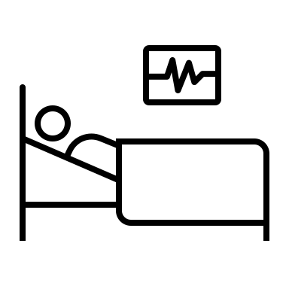

Model Validation
ü
Hospital 1
x
Hospital 2
Trained Model
…
x
Hospital N

Slide 5
Model Validation
ü
Hospital 1
ü
Hospital 2
Trained Model
…
ü
Hospital N

Slide 6
Challenges
You have often a very limited dataset at disposal
You do not have the data from Hospital 2, 3, …, N
How can you check that the model is working with the data of all hospitals?
Or in “machine learning” terminology, how can you verify that your model generalise well?

Slide 7
Model Validation
Model validation refers to the process of confirming that the model actually achieves its intended purpose.
The intended purpose of a model is, in almost all cases, to be able to find patterns in data with an expected level of performance on unseen data (generalisation) statistically similar to the one used for training.

Slide 8
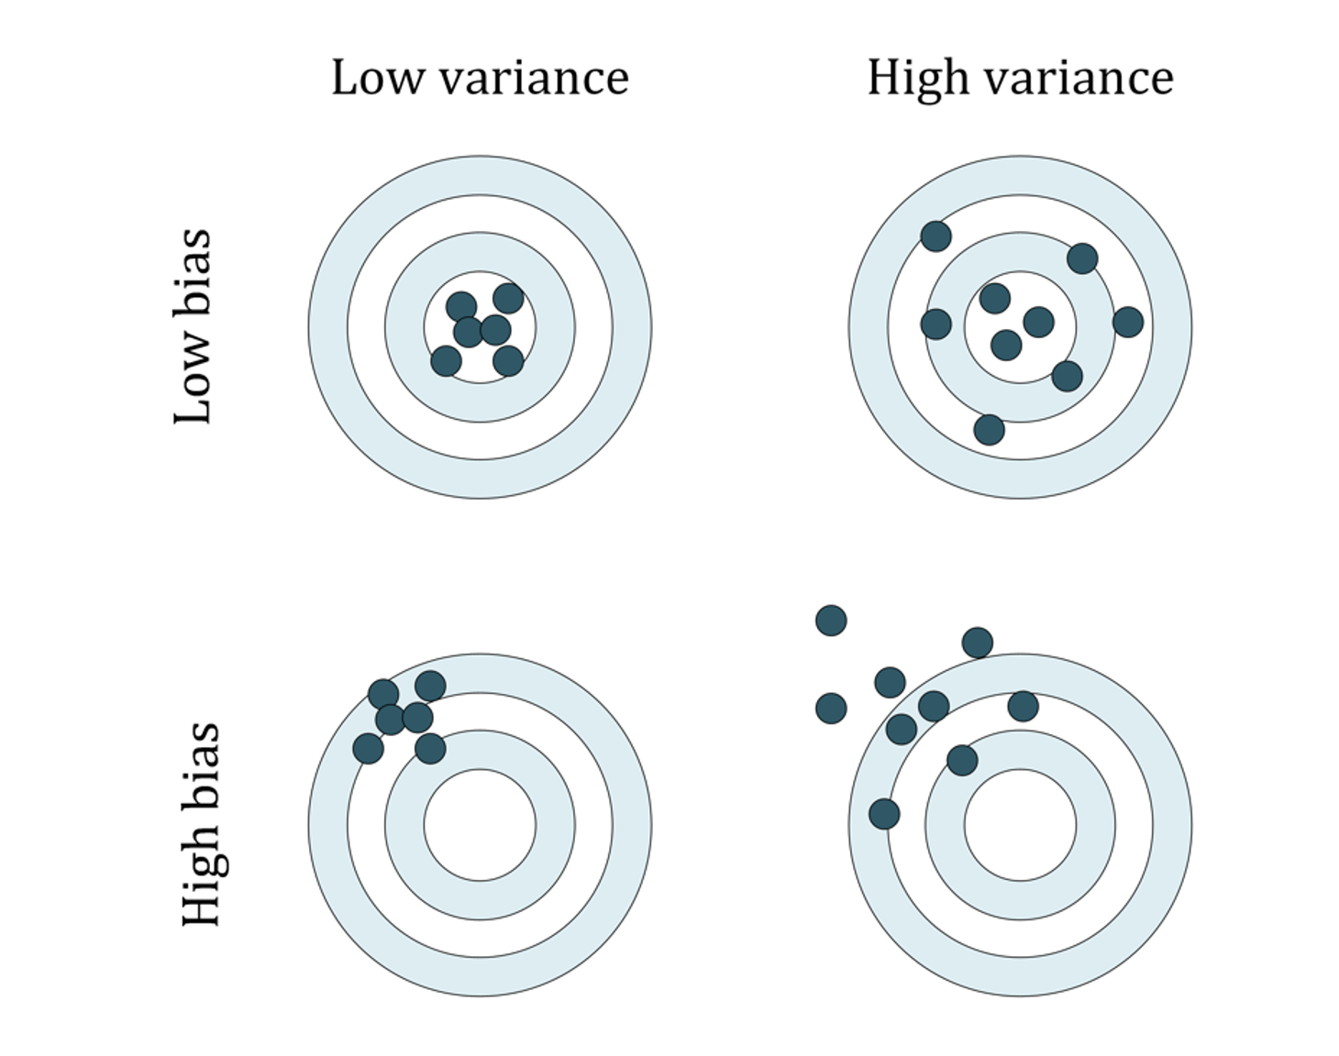
Some terminology: variance and bias
U. Michelucci, Applied Deep Learning with TensorFlow 2, Springer Nature, 2022

Slide 9
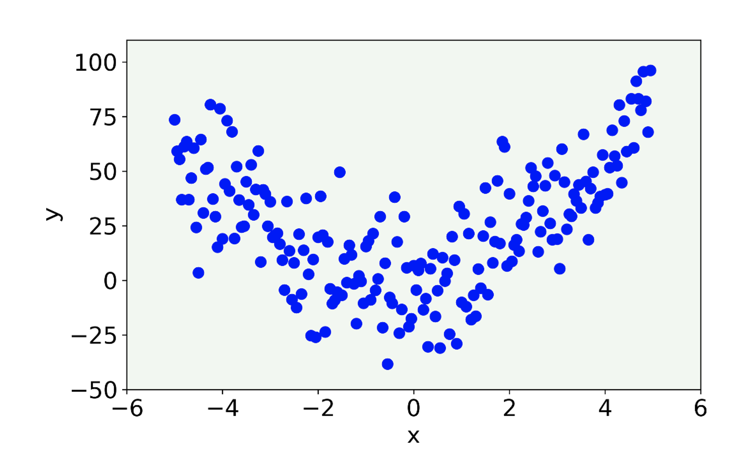
Overfitting I
Let us consider a set of data generated from a quadratic formula with some noise added.
U. Michelucci, Applied Deep Learning with TensorFlow 2, Springer Nature, 2022

Slide 10
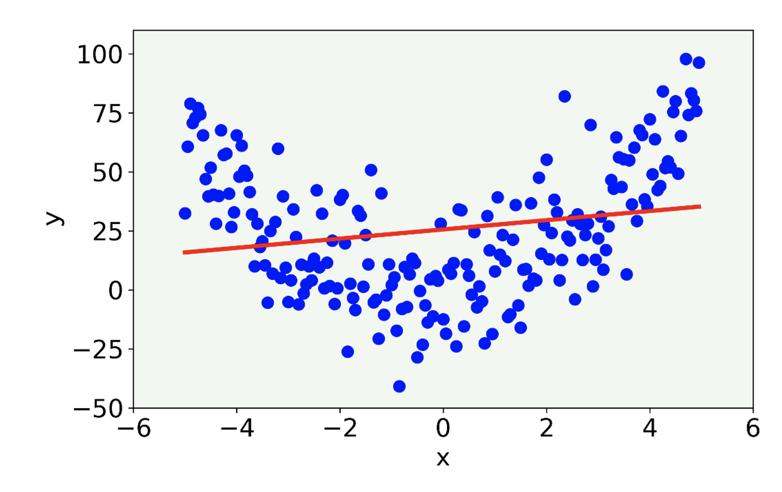
Overfitting II
The linear model misses the main features of the data being too simple. In this case the model is said to have high bias.
U. Michelucci, Applied Deep Learning with TensorFlow 2, Springer Nature, 2022

Slide 11
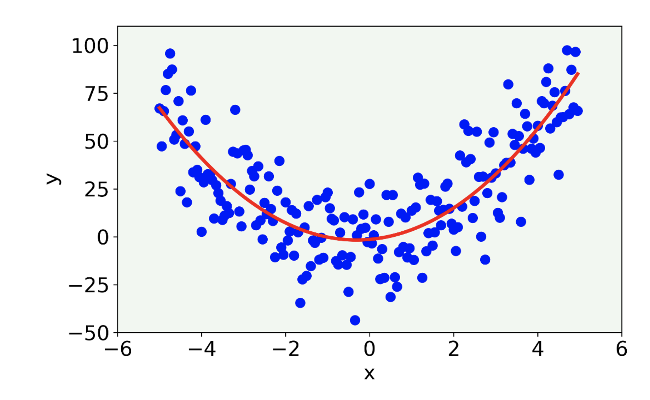
Overfitting III
The result (red line) for a 2-degree polynomial.
U. Michelucci, Applied Deep Learning with TensorFlow 2, Springer Nature, 2022

Slide 12
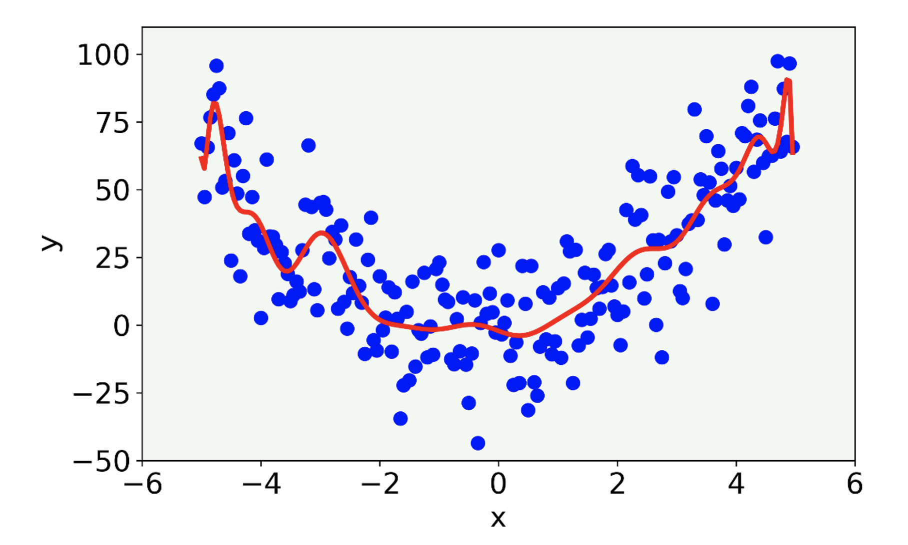
Overfitting IV
The result for a 21-degree polynomial model.
Here we talk about overfitting, since the model capture the noise present in the data. The model is too complex.
U. Michelucci, Applied Deep Learning with TensorFlow 2, Springer Nature, 2022

Slide 13
Overfitting V
A model may, due to its flexibility, learn patterns that are due to noise, errors or simply wrong data.
How can we detect it? How can we visualise its occurrence?
When overfitting occurs, the model evaluated on unseen data will have a bad performance.

Slide 14
Overfitting VI
In 99.9999% of cases a visualisation is not possible, so how can we detect it?
→ To detect it we need to test our model on unseen data. To achieve this, we need to split our dataset in two portions.

Slide 15
Hold-out Approach
Also called Hold-out set
Dataset
Training Set
Test Set
Train the model
Evaluate the model
Evaluate the metric
Evaluate the metric
Compare the two metric values

Slide 16
Hold-out Approach
If the train and test value of (for example) the error is similar → the model generalise well (kind of, at least it behaves similary on the two sets)
If the train and test value of (for example) the error is different → the model generalise badly (kind of, it behaves differently on the two sets)

Slide 17
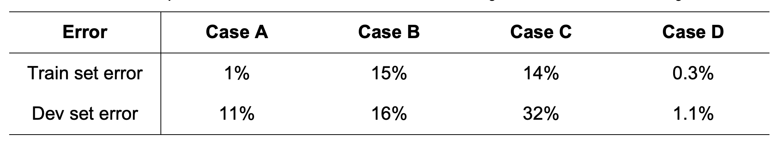
Case A: here we are overfitting (high variance), because we are doing very well on the training set, but our model generalizes very badly to our dev set
Case B: here we see a problem with high bias, meaning that our model is not doing very well generally, on both datasets
Case C: here we have a high bias (the model cannot predict very well the training set) and high variance (the model does not generalize well on the dev set).
Case D: here everything seems ok. Good error on the train set and good on the dev set. That is a good candidate for our best model.
U. Michelucci, Applied Deep Learning with TensorFlow 2, Springer Nature, 2022

Slide 18
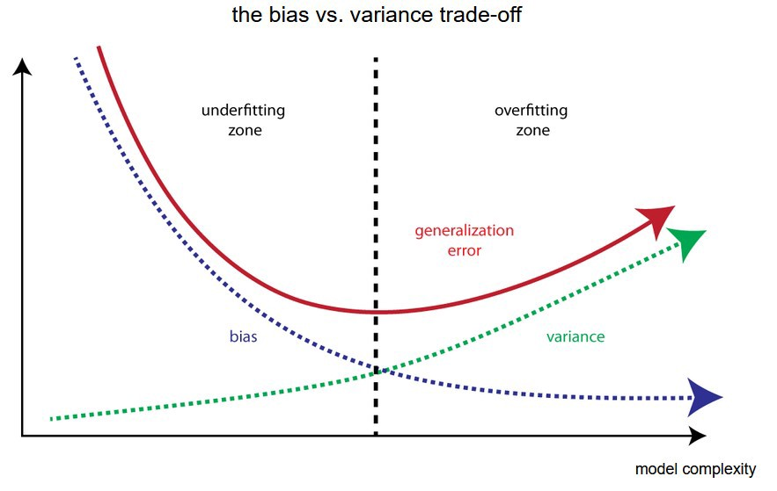
Bias-Variance Trade-off
Error
Error evaluated on the
“test” dataset
Error evaluated on the
“train” dataset
Image © Towarddatascience.com

Slide 19
Essence of overfitting
Note The essence of overfitting is to have unknowingly extracted some of the residual variation (i.e. the noise) as if that variation represented underlying model structure. The opposite is called underfitting when the model cannot capture the structure of the data

Slide 20
Effect of randomness in the data – Hands-on Experiment
https://colab.research.google.com/github/toelt-llc/MSCA-ITN-PARENT/blob/main/DETERMINED2022/Introduction%20to%20model%20validation%20and%20unbalanced%20datasets/.ipynb_checkpoints/Metrics_Distributions_due_to_Datasetsplit-checkpoint.ipynb

Slide 21
Hold-out Approach with multiple splits
Dataset
Training Set
Test Set
N times
N times
Train the model
Evaluate the model
Evaluate the metric
Evaluate the metric

Slide 22
How to communicate results from ML models
When communicating results from ML models:
Always estimate expected value (mean) and variance (or standard deviations) of relevant metrics.
→Never only communicate one single number.

Slide 23
Main Validation techniques
Hold-out approach (multiple Train-test split approach)
K-fold cross validation
Additional Methods not discussed today:
Bootstrap, Leave-one-out Cross Validation, Jackknife, Subsampling, etc.
Michelucci, Umberto, and Francesca Venturini. "Estimating neural network’s performance with bootstrap: A tutorial." Machine Learning and Knowledge Extraction 3.2 (2021): 357-373.

Slide 24
K-Fold Approach
You get K values of the chosen metric.
→ You can evaluate mean and variance of the metric for the training and for the test set.

Slide 25
Some tips and remarks
K-Fold is typically used when the dataset is small. Typically one chooses K=5-10 (the higher the more computational requirements you have)
Leave-one-out (K-Fold with K=1) is used for very small datasets
Hold-out with multiple split is often used
Comparison of models (and thus of mean and variance) requires statistical tests (like the t-test) (that we cannot cover in this lecture)

Slide 26
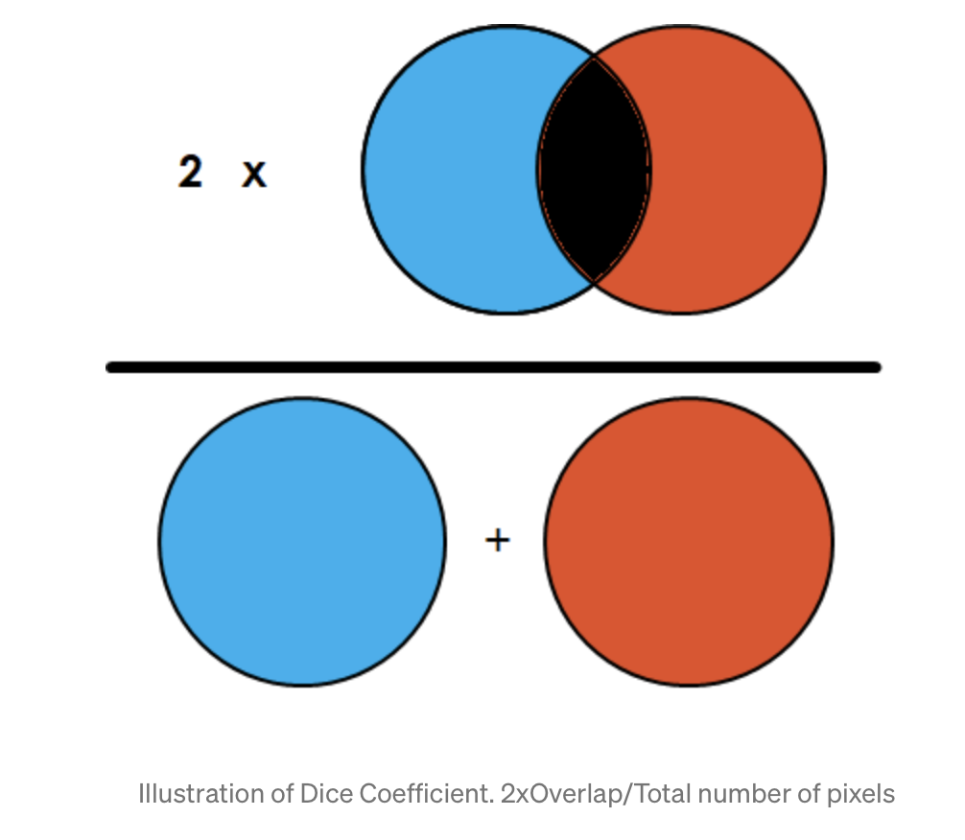
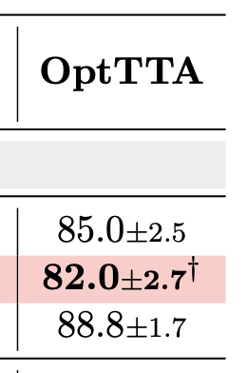
An example
Image Source: towarddatascience.com
Dice (%) Results (+/- std dev.)
From: Tomar, Devavrat, et al. "OptTTA: Learnable Test-Time Augmentation for Source-Free Medical Image Segmentation Under Domain Shift." Medical Imaging with Deep Learning. 2021.

Slide 27
Comparing Models (model selection) Further Reading
https://www.cs.cmu.edu/afs/cs/academic/class/10601-f10/lecture/lec16.pdf
http://faculty.washington.edu/yenchic/18W_425/Lec17_Model.pdf
http://www.cs.tau.ac.il/~mansour/ml-course-10/scribe11.pdf

